Slide 1
CS-513
Knowledge Discovery and Data Mining
‘The Coding Brats’

Slide 2



Corporate Termination Assessment
Shrey Kshatriya Kavit Shah Avirat Belekar
Course: CS 513-B
Department: MIS
Level: Graduate student
Course: CS 513-B
Department: MIS
Level: Graduate student
Course: CS 513-B
Department: CS
Level: Graduate student

Slide 3
Problem Statement
Employees are an integral part of an organization. They make up the organization and are the ones responsible for smooth functioning of the company.
However, employees are not always loyal, or the company might fire them due to a financial crisis. Either way, it is always a loss for the company.
We aim to to develop a classification model(s) to predict the potential of employees leaving the company (become terminated).

Slide 4
Data Set Explanation
The Data set (attrition_data.csv) has 9617 Rows and 27 Columns.
The data set from has the information about employee details like employee id, annual rate, hourly rate etc.
The task is to predict the potential of employees leaving the company.

Slide 5
Preprocessing
We removed the termination year column in the dataset because of missing values and it contributed the least towards the target column Status
We also removed specific columns based on relevance of the data such as hourly rate, employee id, etc
We have converted all categorical values to numerical values.

Slide 6
Feature Selection Algorithms
Forward and Backward Selection
Boruta
Earth

Slide 7
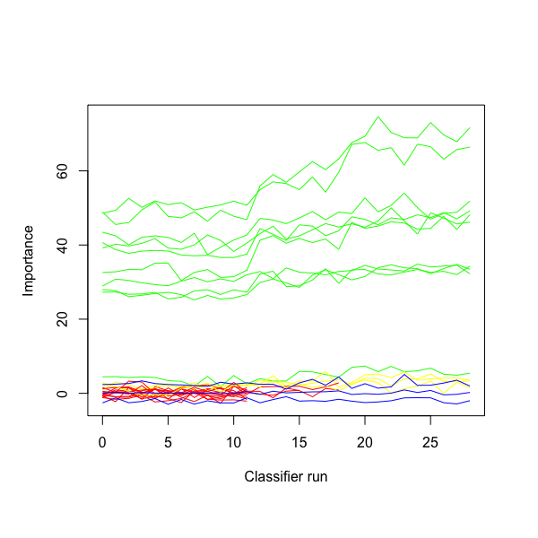
Boruta Algorithm
Features Selected:
Annual rate
Hourly rate
Job code
Job Group
Previous year 1
Previous year 2
Previous year 3
Previous year 4
Previous year 5

Slide 8
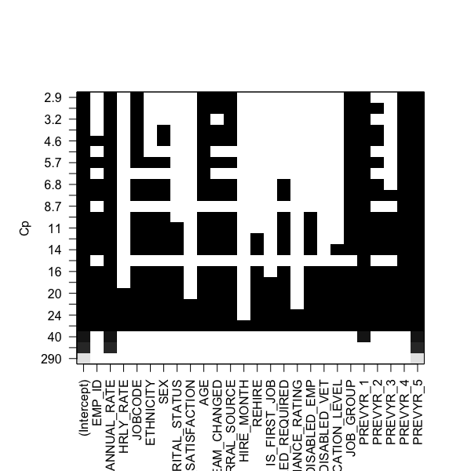
Forward and Backward Selection
Features Selected:
Annual rate
Hourly rate
Job code
Job Group
Previous year 1
Previous year 2
Previous year 3
Previous year 4
Previous year 5
Features Selected:
Annual rate
Age
Job code
Number of Teams
Referral Source
Job group
Previous year 1
Previous year 4
Previous year 5

Slide 9
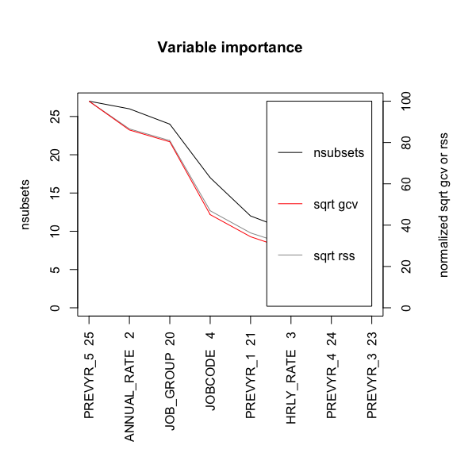
Earth Algorithm
Features Selected:
Annual rate
Hourly rate
Job code
Job Group
Previous year 1
Previous year 3
Previous year 4
Previous year 5

Slide 10
Features Selected for Training Classification Algorithm
Annual Rate | Job Code
Hourly Rate | Job Group
Previous Year 1 | Previous Year 3
Previous Year 4 | Previous Year 5

Slide 11
Classification Algorithms
Logistic Regression | K nearest neighbour k = 5
Naive Bayes | K nearest neighbour k = 7
Support Vector Machine | K nearest neighbour k = 10
Random Forest | Decision Tree
Artificial Neural Network | C50 Algorithm
K nearest neighbour k = 3 | Mean Discriminant Analysis

Slide 12
Logistic Regression
 | Predicted
Actual | Terminated | Attrition
Terminated | 1642 | 0
Attrition | 1236 | 6
Accuracy : 57.142 %

Slide 13
Support Vector Machine
 | Predicted
Actual | Terminated | Attrition
Terminated | 1036 | 520
Attrition | 606 | 722
Accuracy : 60.957%

Slide 14
Random Forest
 | Predicted
Actual | Terminated | Attrition
Terminated | 1349 | 293
Attrition | 411 | 831
Accuracy : 75.589%

Slide 15
Naive Bayes
 | Predicted
Actual | Terminated | Attrition
Terminated | 1005 | 789
Attrition | 268 | 822
Accuracy : 63.345%

Slide 16
Artificial Neural Network
 | Predicted
Actual | Terminated | Attrition
Terminated | 1080 | 255
Attrition | 797 | 271
Accuracy : 56.221%

Slide 17
Mean Discriminant Analysis
 | Predicted
Actual | Terminated | Attrition
Terminated | 866 | 469
Attrition | 470 | 598
Accuracy : 60.923%

Slide 18
Decision Tree
 | Predicted
Actual | Terminated | Attrition
Terminated | 983 | 362
Attrition | 395 | 663
Accuracy : 68.497%

Slide 19
C50 Algorithm
 | Predicted
Actual | Terminated | Attrition
Terminated | 1101 | 246
Attrition | 340 | 716
Accuracy : 75.614%

Slide 20
K-Nearest Neighbour with 3 neighbours
 | Predicted
Actual | Terminated | Attrition
Terminated | 1019 | 306
Attrition | 395 | 683
Accuracy : 71.24%

Slide 21
K-Nearest Neighbour with 5 neighbours
 | Predicted
Actual | Terminated | Attrition
Terminated | 1033 | 292
Attrition | 419 | 659
Accuracy : 71.32%

Slide 22
K-Nearest Neighbour with 7 neighbours
 | Predicted
Actual | Terminated | Attrition
Terminated | 1049 | 276
Attrition | 426 | 652
Accuracy : 71.53%

Slide 23
K Nearest Neighbour with 10 neighbours
 | Predicted
Actual | Terminated | Attrition
Terminated | 1049 | 276
Attrition | 426 | 652
Accuracy : 71.41%

Slide 24
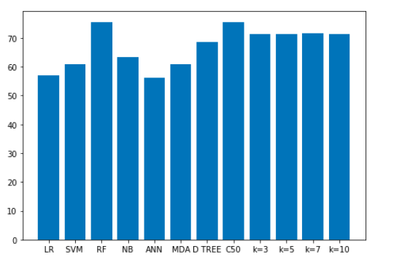
Conclusion
Random Forest and C50 algorithm are the best performing algorithms needed to classify whether an employee is leaving by choice or is terminated.

